Slide 1
Problems in OTEC plant
Corrosive sea water
Large size of heat exchanger and large volumes of sea water to be circulated.
High installation cost.
Low temperature of ocean water, low efficiency of thermal cycle.
High cost of electrical energy obtained from OTEC plant.

Slide 2
Energy from tides
Tide is periodic rise and fall of water level of the sea. Tides occur due to the attraction of sea water by the moon.
Tides contain large amount of potential energy which is used for power generation.
When the water is above the mean sea level, it is called flood tide.
When water level is below the mean level it is called ebb tide.

Slide 3
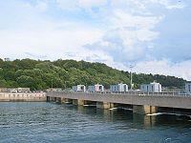
Rance Tidal Power Station

Slide 4
-Barrage Tidal Power: Rance Power Station-
Located on Rance River, France
750 meters long
24 Turbines
Capacity of 240MW
Annual output of 600GWh
Supplies 0.012% of Frances power supply.
Opened 1966

Slide 5
BASICS
Cause of tides: gravitational force of sun, moon and earth’s rotation
Two tidal cycles per day: 12 hours, 25 minutes
Tidal range – large at coastal regions with high depth gradient
per day: 12 hours, 25 minu
Water can be stored in an estuary during high tide
Release during low tide, through turbines

Slide 6
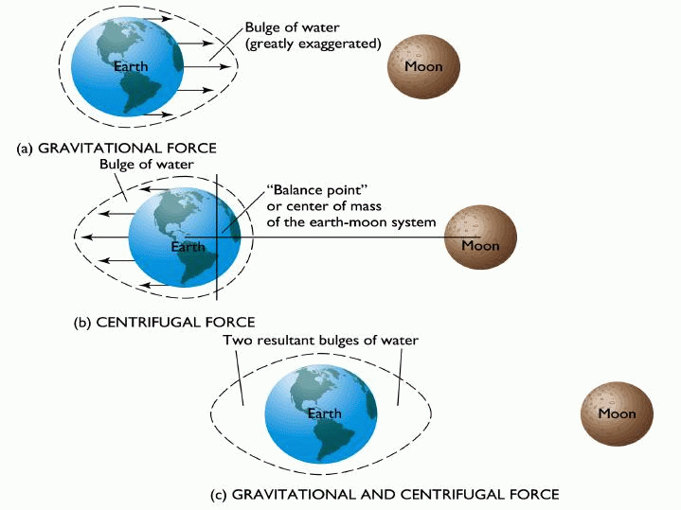
Basic physics of tides
There are two high tides and two low tides during each period of rotation of the earth.
Spring and Neap tides depend on the orientation of the sun, moon, and the earth.
High spring tides occur when the sun and moon line up with the earth. This occurs whether they are either on same or opposite side.
Low neap tides occur when the sun and moon line up at 90 ͦ to each other.
When a landmass lines up with the earth-moon system, the water around it is at high tide.
When a landmass is at 90 ͦ to the earth-moon system, the water around it is at low tide.

Slide 7
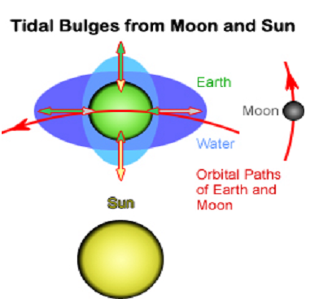
Why there are tides

Slide 8
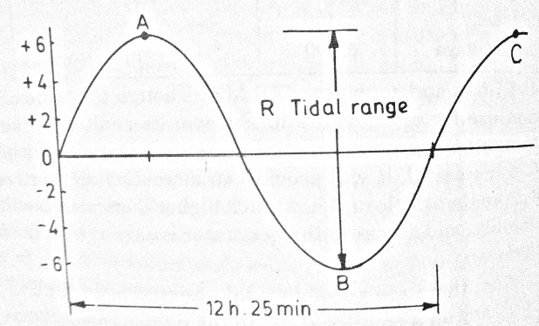
Tides of sea

Slide 9
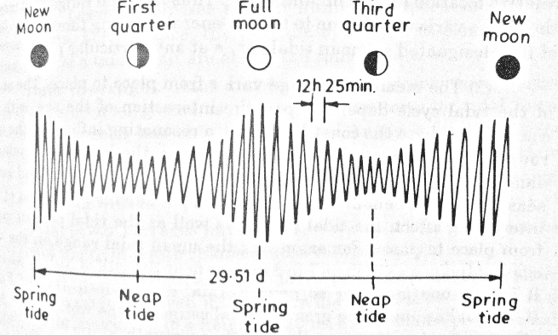
Relative high and low tide-Lunar month

Slide 10
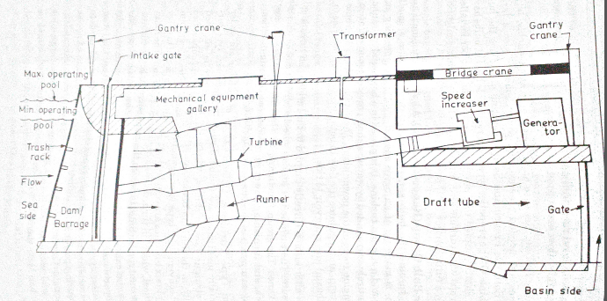
Schematic layout of tidal power plant

Slide 11
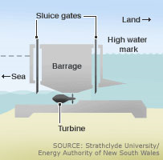
Tidal Barrage
Utilize potential energy
Tidal barrages are typically dams built across an estuary or bay.
consist of turbines, sluice gates, embankments, and ship locks.
Basin

Slide 12
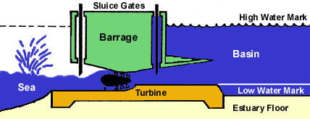

Slide 13
Components of a tidal power station are:
A barrage: a barrage is a small wall built at the entrance of a gulf in order to trap water behind it. It will either trap it by keeping it from going into the gulf when water levels at the sea are high or it will keep water from going into the sea when water level at the sea is low.
Turbines: they are the components responsible for converting potential energy into kinetic energy. They are located in the passageways that the water flows through when gates of barrage are opened. There are many types of turbines used in tidal power stations:
Bulb turbines: these are difficult to maintain as water flows around them and the generator is in water.
Rim turbines: these are better maintained than the bulb turbines but are hard to regulate as generator is fixed in barrage.
Tubular turbines: these turbines are fixed to long shafts and thus solve both problems that bulb and rim turbines have as they are easier to maintain and control.
Sluices: sluice gates are the ones responsible for the flow of water through the barrage.

Slide 14
Principle of Tidal power generation
The ocean tides rise and fall and water can be stored during the rise period and it can be discharged during fall.
A dam is constructed separating the tidal basin from the sea and a difference in water level is obtained between the basin and sea.
During high tide period, water flows from the sea into the tidal basin through the water turbine.
The height of tide is above the tidal basin.
Hence the turbine unit operates and generates power, as it is directly coupled to a generator.
During low tide period, water flows from tidal basin to sea, as the water level in the basin is more than that of the tide in the sea.
During this period also, the flowing water rotates the turbine and generates power.
The generation of power stops only when sea level and the tidal basin level are equal.

Slide 15
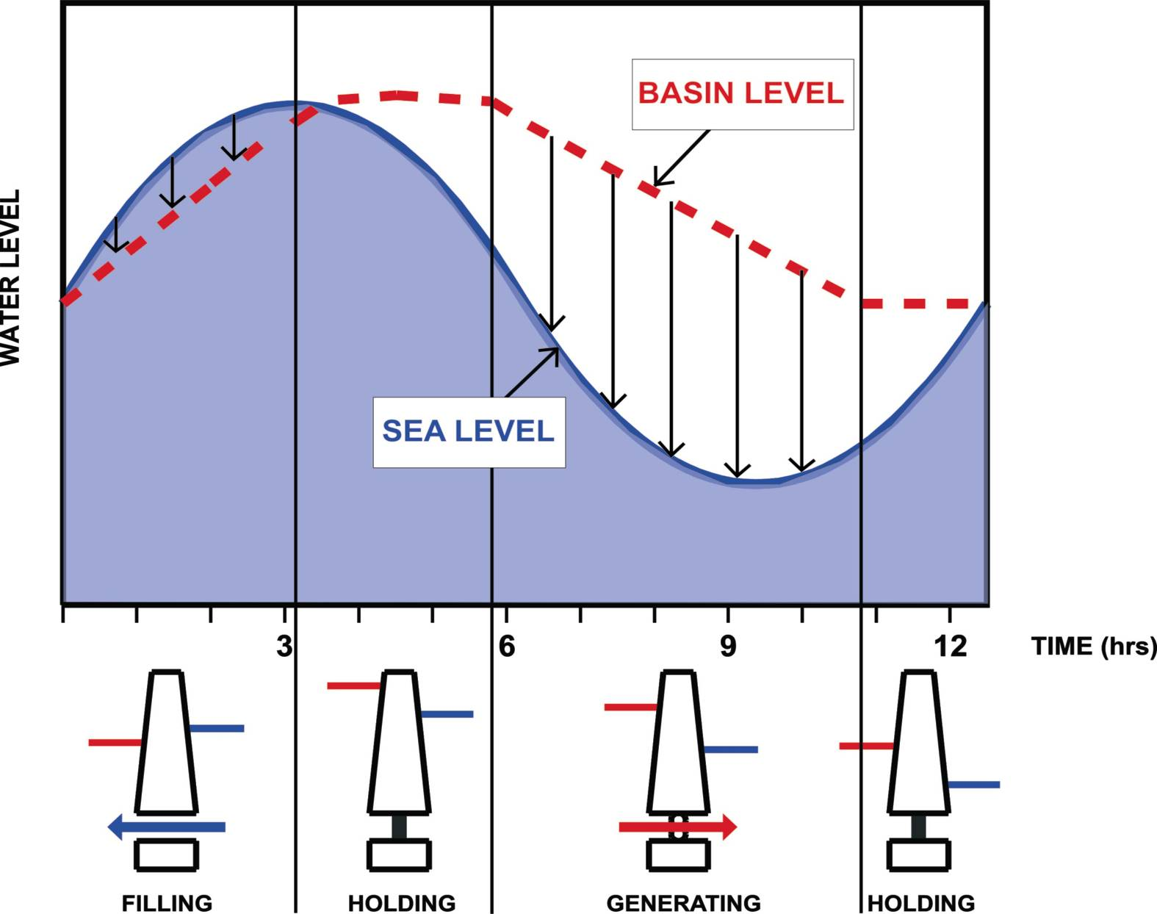

Slide 16
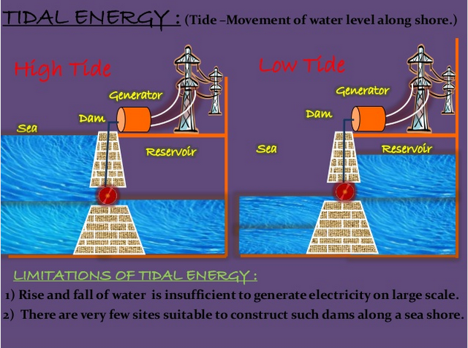

Slide 17
Operation methods of utilization of Tidal power
Single basin system-
Single Ebb cycle system (Ebb generation):
During flood tide basin is filled and sluice gates are closed , trapping water. Gates are kept closed until the tide has ebbed sufficiently and thus turbines start spinning and generating electricity.
Single tide cycle (Flood generation):
The basin is filled through the turbine which generate at flood tide.
Double cycle (Two way generation): Sluice gates and turbines are closed until near the end of the flood tide when water is allowed to flow through the turbines into the basin creating electricity. At the point where the hydrostatic head is insufficient for power generation the sluice gates are opened and kept open until high tide when they are closed. When the tide outside the barrage has dropped sufficiently water is allowed to flow out of the basin through the turbines again creating electricity.
Double-basin system: There are two basins, but it operates similar to en ebb generation, single-basin system. The only difference is a proportion of the electricity is used to pump water into the second basin allowing storage.

Slide 18
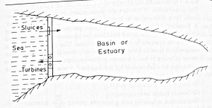
Single basin operation

Slide 19
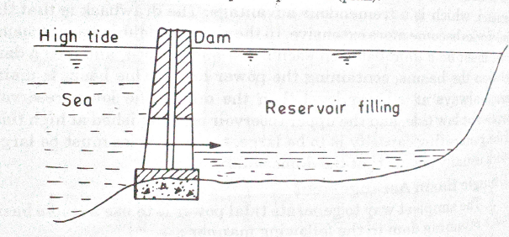
Sluice gates open, Turbine shut off

Slide 20
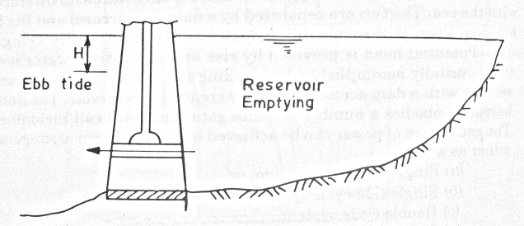
Sluice gates shut, Turbine operation

Slide 21
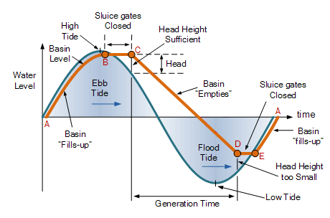
Power Generation during Ebb Tide

Slide 22
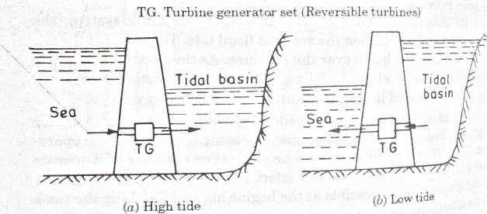
Double cycle

Slide 23
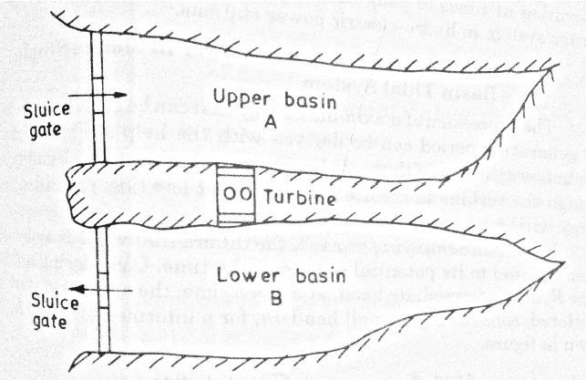
Tidal power plant double basin operation

Slide 24
Tidal power in India
To capture sufficient power from the tidal energy potential, the height of high tide must be at least five meters (16 feet) greater than low tide.
There are only approximately 20 locations on earth with tides this high and India is one of them.
The Gulf of Cambay and the Gulf of Kutch in Gujarat on the west coast have the maximum tidal range of 11m and 8m with average tidal range of 6.77m and 5.23m respectively.

